Slide 1
E-commerce Customer Segmentation and Prediction

Slide 2


Slide 3


BOSTON INSTITUTE OF ANALYTICS
CAPSTONE PROJECT
Name | Vatsal Sunilkumar Shah
Project Title | E-commerce Customer Segmentation and Prediction
Mentor’s Name | Shivam Sir Rai

Slide 4
Project Overview
The world is getting smarter day by day. The role of E-Commerce in our life is becoming unavoidable. Nowadays right from socks to shoes, dresses to apparel, electronics to appliances, everything we totally depend on E-Commerce websites for the best products. It is a modern-day business that works extensively with the help of technology. In simple words, the process of buying products online is E-commerce shopping. Nowadays slowly the trend of moving from traditional window shopping or going physically to stores is declining. People tend to think more of shopping online than going to shops. Customer is the most important aspect of any business, a business cannot achieve success without this key factor. They need to satisfy customer needs always. In order to do that customer data need to be analyzed from their websites.
This project aims to enhance marketing strategies and customer retention for an e-commerce company by gaining a deeper understanding of their customer base based on their purchasing patter. By leveraging machine learning, the project seeks to segment customers and predict future purchasing behavior. The goal is to develop a robust customer segmentation model and a predictive classifier to categorize customers based on their purchasing patterns, enabling the company to tailor marketing strategies, improve customer retention, and optimize inventory management.

Slide 5

E-commerce Customer Segmentation and Prediction
This presentation outlines a data science project focused on customer segmentation and prediction for an e-commerce company. By leveraging machine learning algorithms, the project aims to provide valuable insights into customer behavior and develop effective strategies to optimize marketing, improve customer retention, and streamline inventory management.

Slide 6
Project Objectives
Customer Segmentation
Predictive Modeling
The project aims to develop a robust customer segmentation model based on purchasing patterns, demographics, and other relevant customer data. This will enable the company to identify distinct customer groups and understand their unique needs and preferences.
A predictive classifier will be built to forecast future purchasing behavior for each customer segment. This will allow the company to anticipate customer needs, personalize marketing efforts, and optimize inventory management.

Slide 7

Data Acquisition and Preparation
1
Data Collection
2
Data Cleaning
Relevant customer data will be collected from various sources within the company's existing systems, including sales records, website activity, marketing campaign data, and customer surveys.
Collected data will be cleaned and preprocessed to handle missing values, remove duplicates, and ensure consistency in formatting. This step is crucial for building accurate and reliable models.
3
Feature Engineering
New features will be engineered from existing data to provide more insights into customer behavior. This may involve creating variables such as purchase frequency, average order value, or recency of purchase.

Slide 8
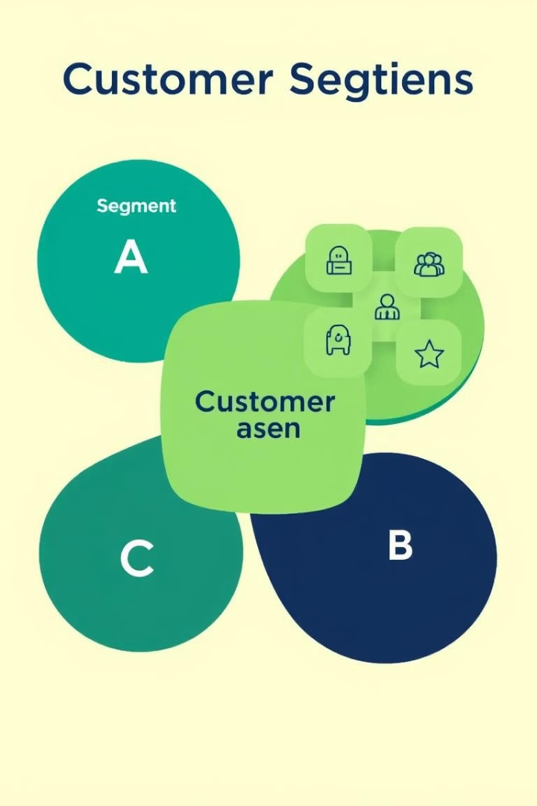
Customer Segmentation Modeling
Clustering Algorithms
Model Evaluation
Various unsupervised learning algorithms, such as k-means clustering, hierarchical clustering, or DBSCAN, will be explored to identify distinct customer segments based on their purchasing patterns and other relevant features.
The performance of the chosen clustering algorithm will be evaluated using metrics like silhouette score, elbow method, and cluster stability to ensure the model effectively identifies meaningful customer groups.
Segment Profiling
Once the segments are identified, they will be profiled based on key characteristics, such as purchase frequency, average order value, product preferences, and demographics. This will provide a deeper understanding of each customer segment.

Slide 9
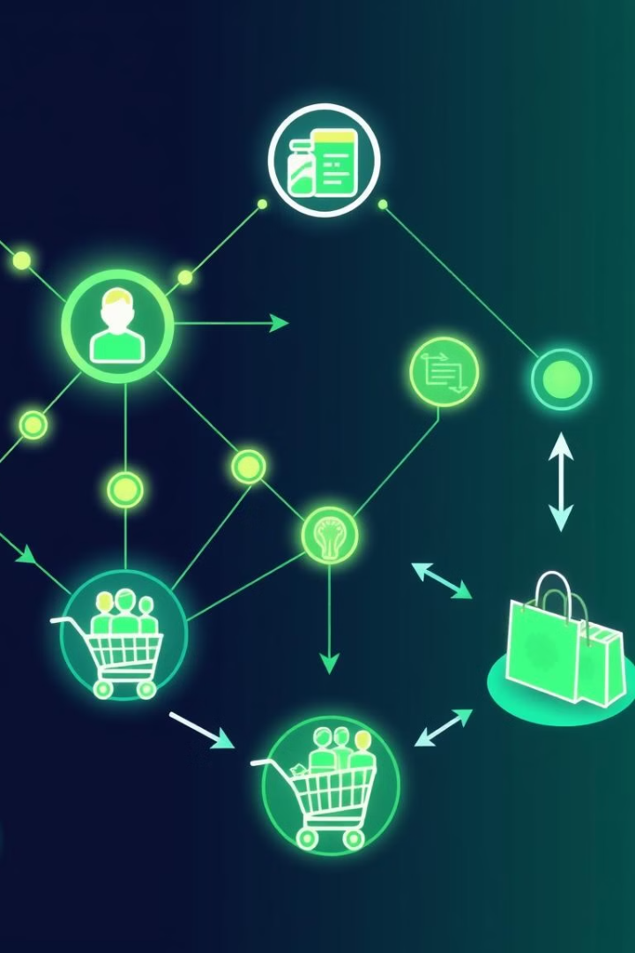



Predictive Modeling for Purchase Behavior
Model Selection
Model Training
Various supervised learning algorithms, such as logistic regression, decision trees, or support vector machines, will be evaluated to build the predictive model. The choice of algorithm will depend on the specific data characteristics and the desired level of accuracy.
The chosen algorithm will be trained on the prepared customer data to learn the relationship between customer features and their purchasing behavior. This training process involves adjusting the model parameters to minimize errors.
Model Evaluation
The performance of the trained model will be evaluated using metrics like accuracy, precision, recall, and F1-score to assess its ability to predict future purchase behavior accurately.

Slide 10

Marketing and Customer Retention Strategies
Personalized Recommendations: The segmentation and predictive models will be used to personalize product recommendations and marketing messages for each customer segment. This personalized approach can improve customer engagement and conversion rates.
Customer Retention Programs: The insights gained from the models can inform the development of targeted customer retention programs. This could include loyalty programs, exclusive offers, or personalized communication strategies to enhance customer loyalty.
1
2
3
Targeted Marketing Campaigns: Marketing campaigns can be tailored to specific customer segments based on their unique needs and preferences. This allows for more effective targeting and improved return on investment for marketing efforts.

Slide 11
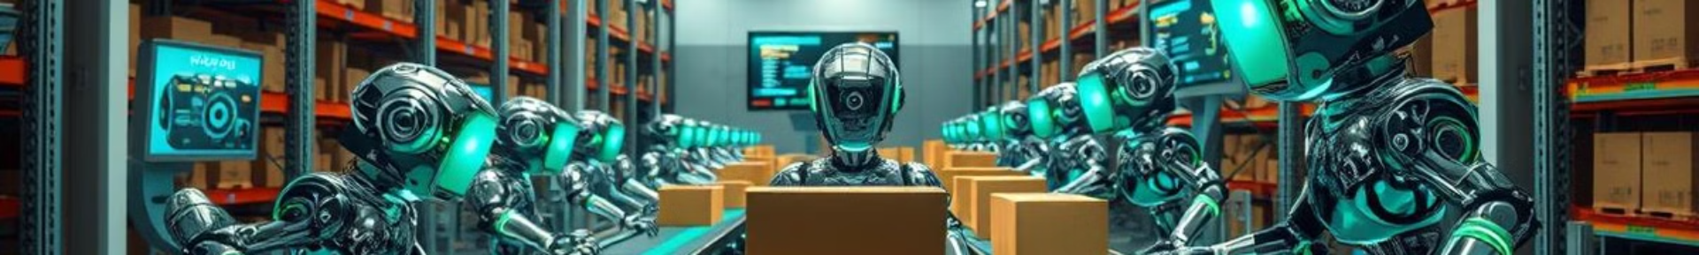



Inventory Management Optimization
Demand Forecasting
The predictive model can be used to forecast demand for specific products within each customer segment. This helps anticipate future demand and optimize inventory levels, reducing stockouts and excess inventory.
Product Sourcing
Insights into customer preferences and purchase behavior can inform product sourcing strategies. The company can prioritize products that are in high demand based on the segmentation and predictive models.
Inventory Optimization
By predicting demand more accurately, the company can adjust inventory levels and optimize storage space to ensure efficient allocation of resources. This leads to cost savings and improved supply chain management.

Slide 12





Project Benefits and Impact
1
Improved Customer Engagement
2
Enhanced Customer Retention
3
Increased Revenue
4
Optimized Inventory Management
5
Sustainable Business Growth

Slide 13
SYSTEM DESIGN
Flow Diagram
Firstly I take the dataset, in my case, it is an E-Commerce dataset, load them using pandas.
Mainly I took first data preprocessing in steps like are :
Filtering
Cleaning
Normalization
Feature Engineering
Encoding
Next, I search for any missing or duplicate values and outliers in any of the rows, as the K-Prototype Algorithm cannot handle any missing or duplicate values.
Also removing outlier based on statistical rules.
Next processing data of EDA.
Next, I seek the categorical column positions from the dataset, and we convert the data frame to a matrix.
Next, I find the optimal number of ‘K’ using the elbow method and then I build the k-prototype model and use the fit_predict for it.
Next, I add the cluster labels and then do interpretation to get the different clusters in which
I identify the customer spending traits.

Slide 14
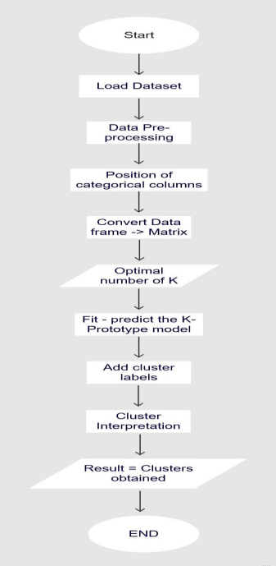

Slide 15
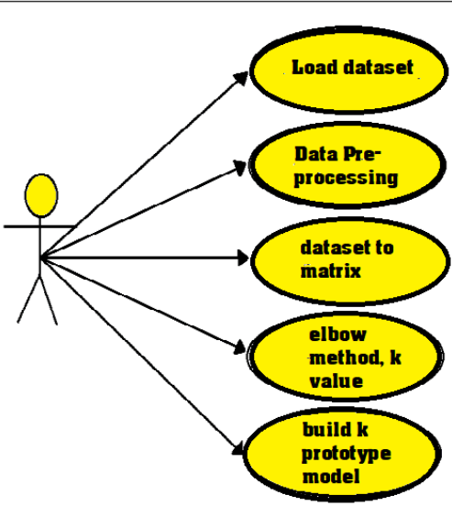

Slide 16
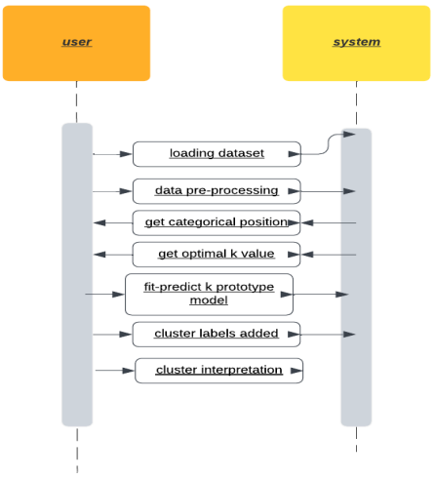
2. System Diagram
Sequential diagram simply shows the interaction between objects in sequential sequence i.e. how
these interactions occur. We can also use the words event drawings or event scenes to refer to a
sequence drawing. Sequential diagrams describe how things in a system work and in what order.

Slide 17
IMPLIEMENTATION
DATASET
The dataset we are using is an e-commerce sales dataset which is from a All Counties include e-commerce website.
I have obtained it from as per given link of dataset. I am considering one important datasets and using them mainly for customers :
Demography of Customers of purchasing items like are invoice no., stock code,
Description, Quantity, Invoice Date, UnitPrice, CustomerID, Country.
In this dataset I have 541909 rows & 8 columns.

Slide 18
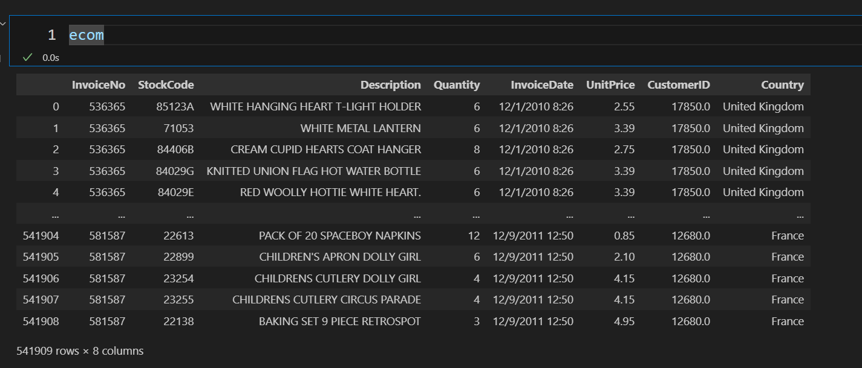

Slide 19
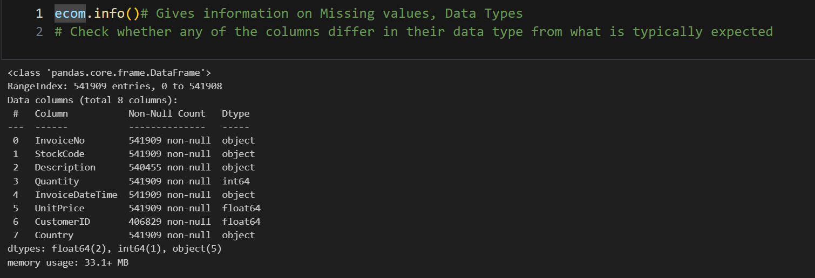
2. Columns Informations

Slide 20
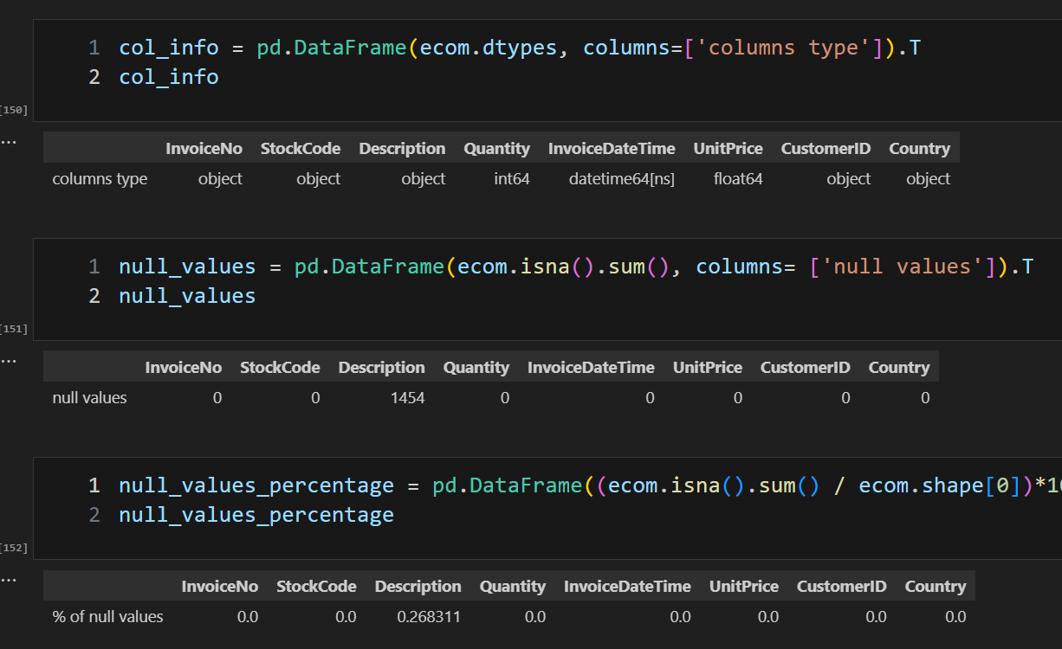
3. Handling Missing Values

Slide 21
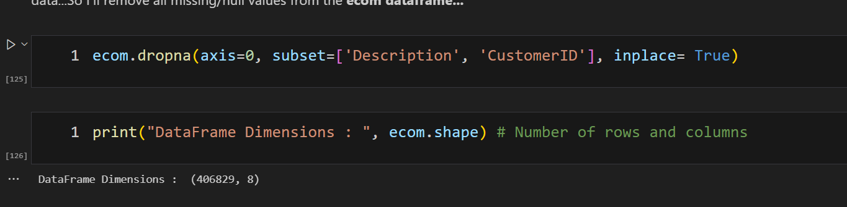
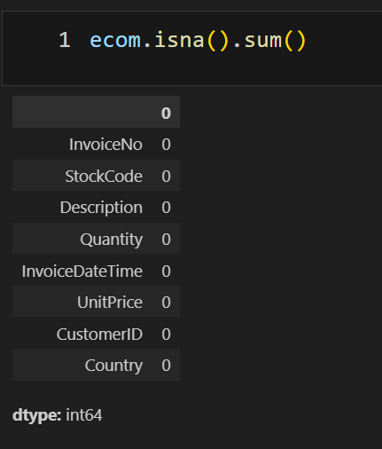

Slide 22
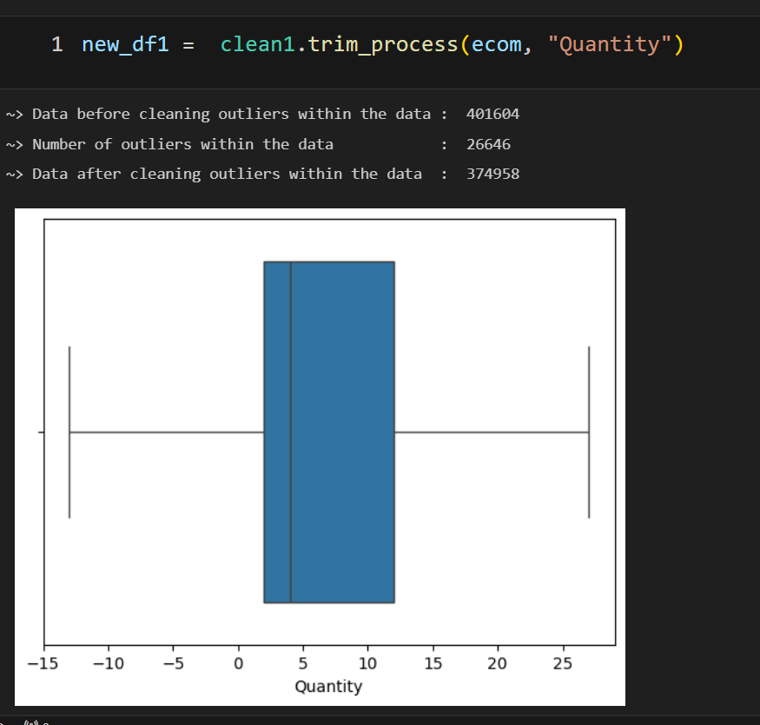
4. Outlier Treatment

Slide 23
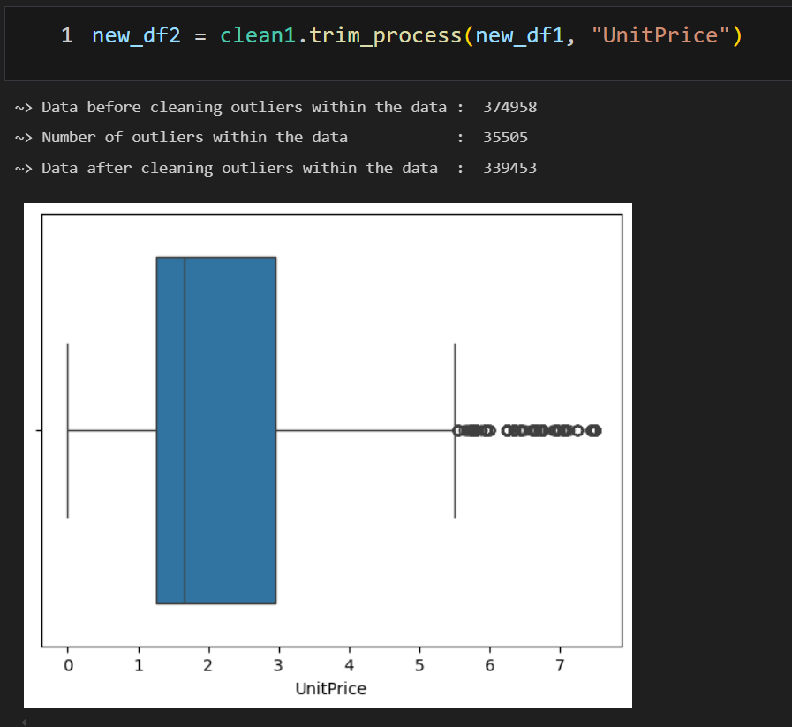

Slide 24
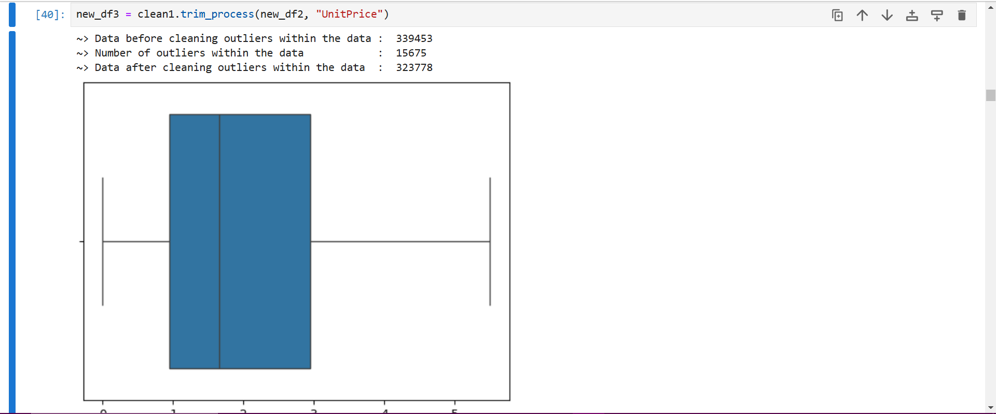

Slide 25
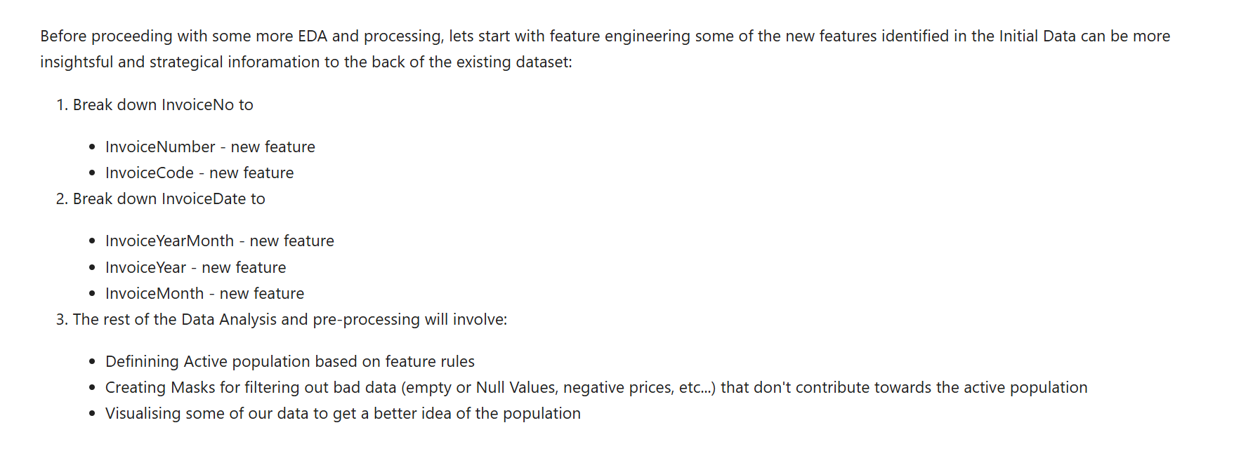
5. Feature Engineering

Slide 26
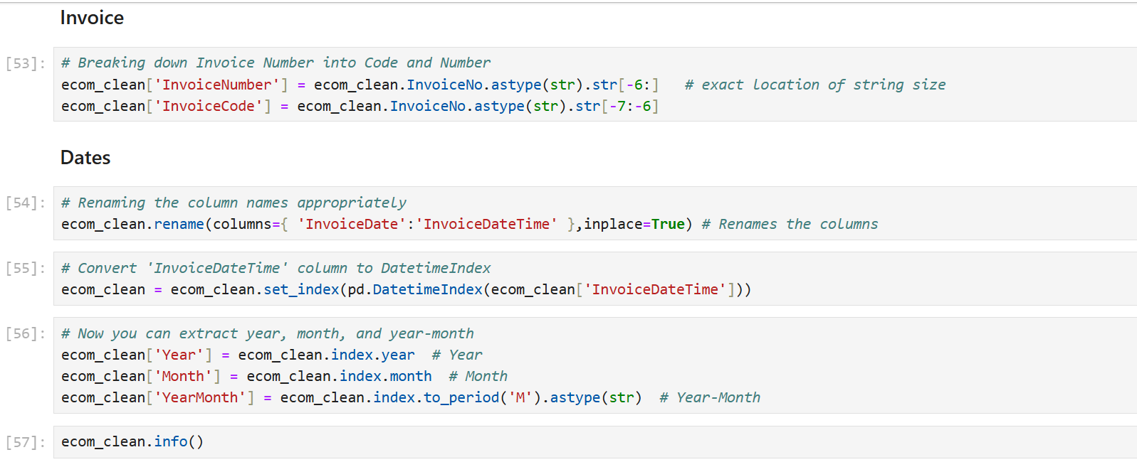

Slide 27
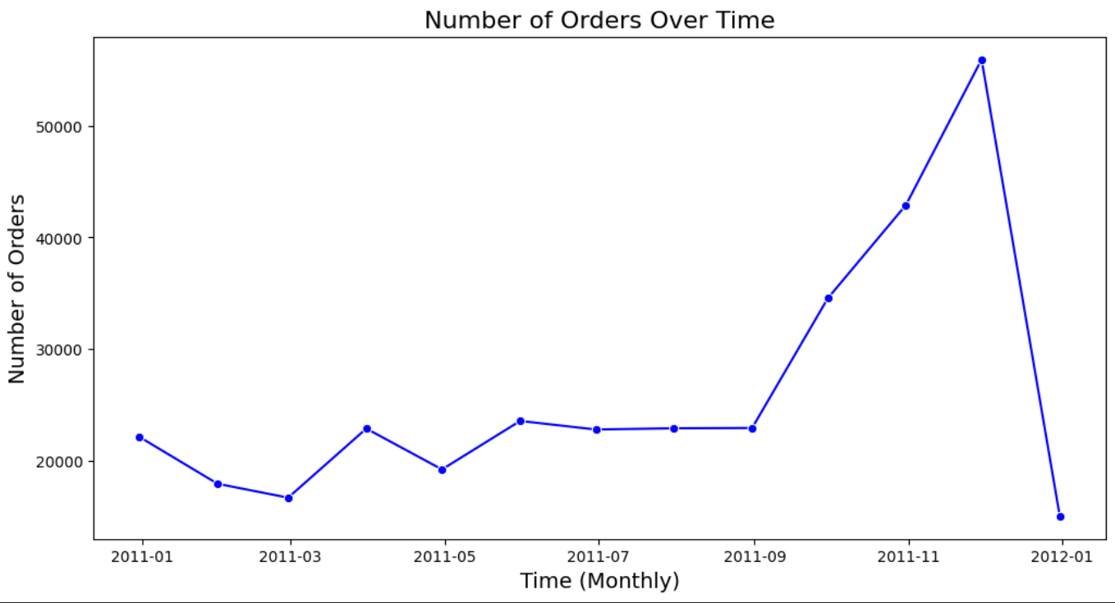
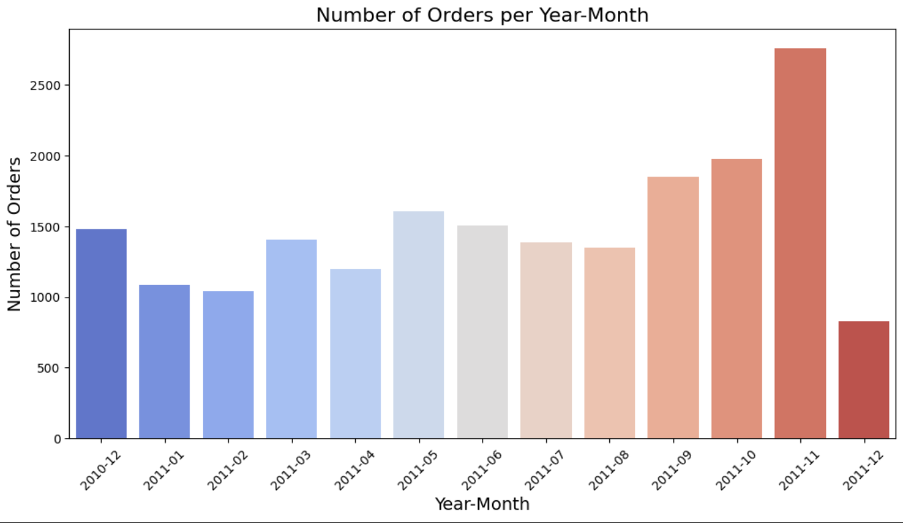

Slide 28
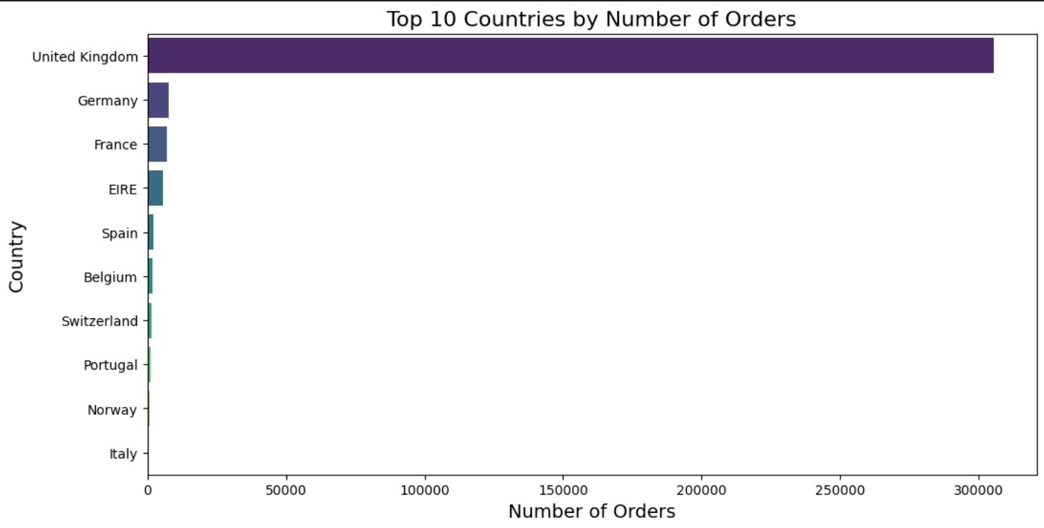
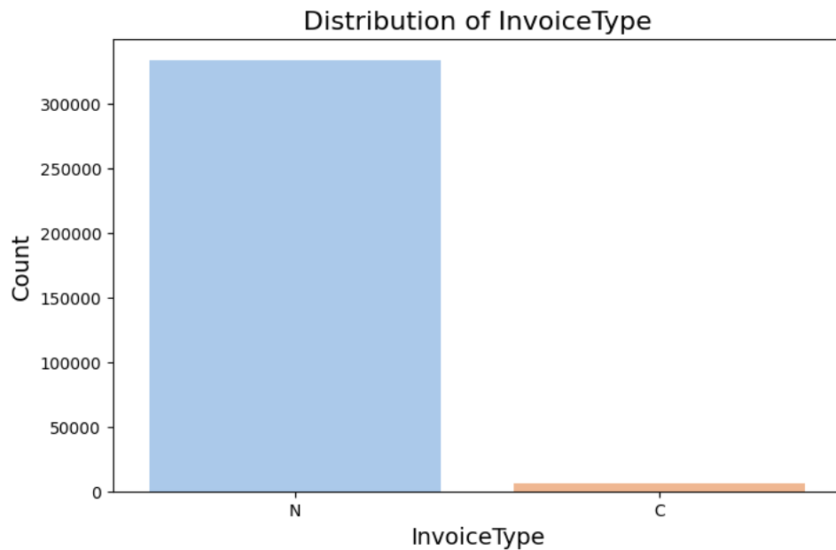

Slide 29
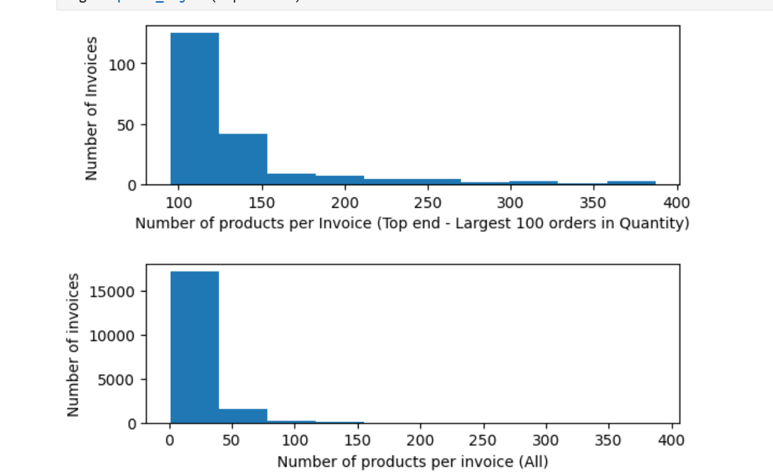

Slide 30
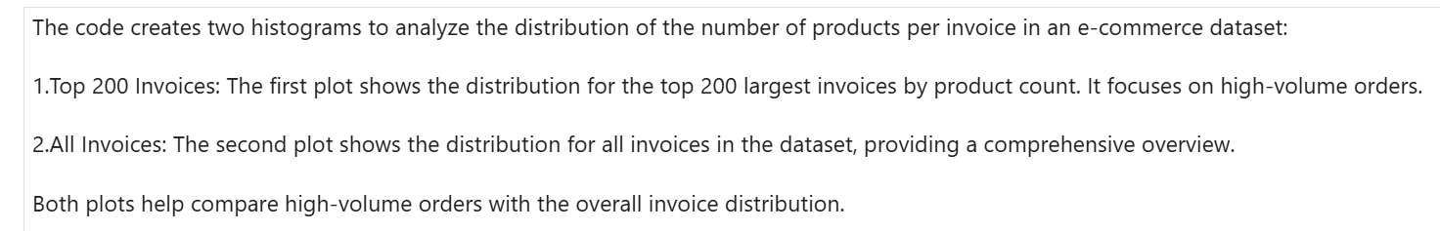

Slide 31
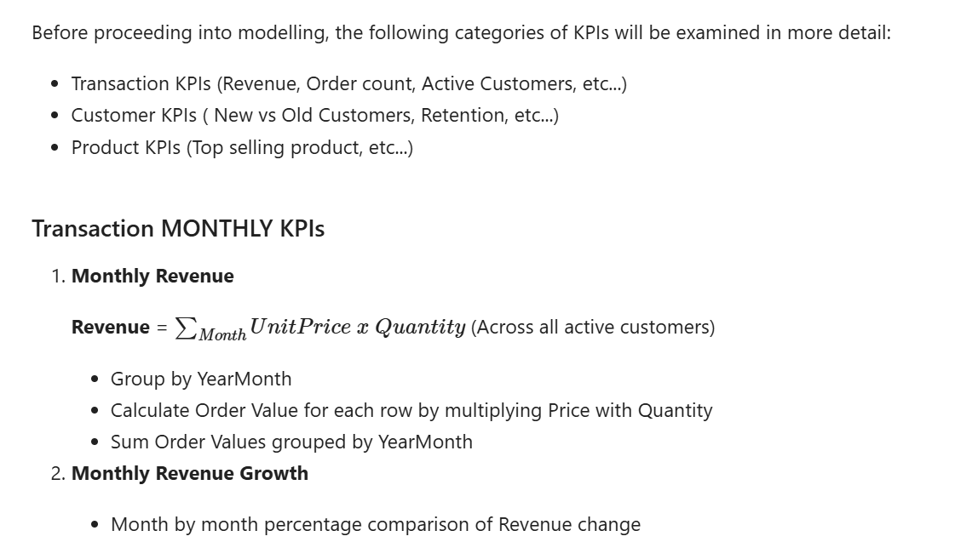
6. Key Performance Indicator

Slide 32
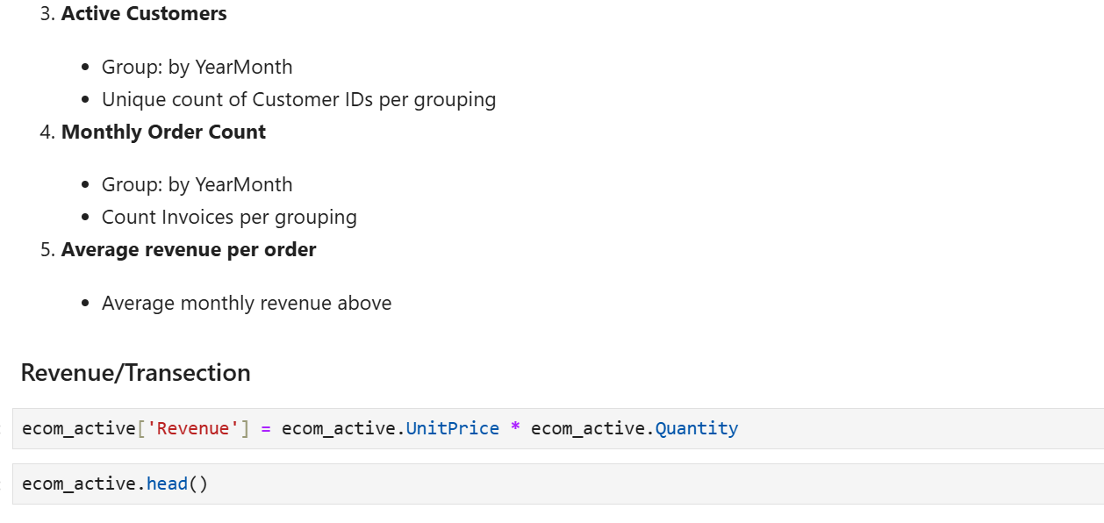

Slide 33
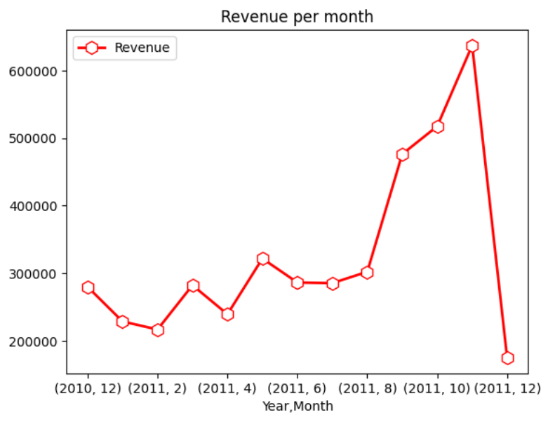
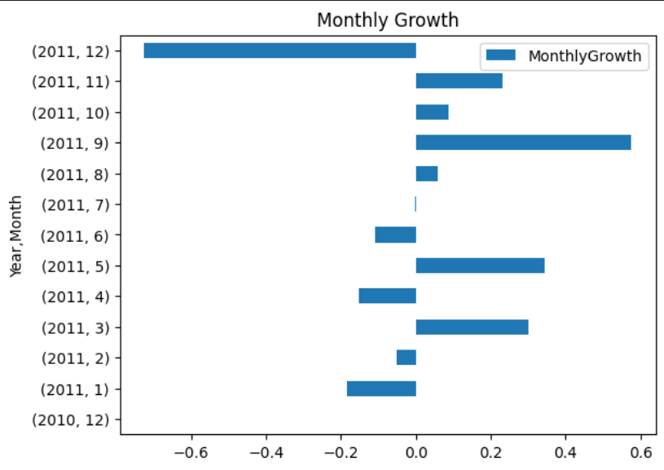
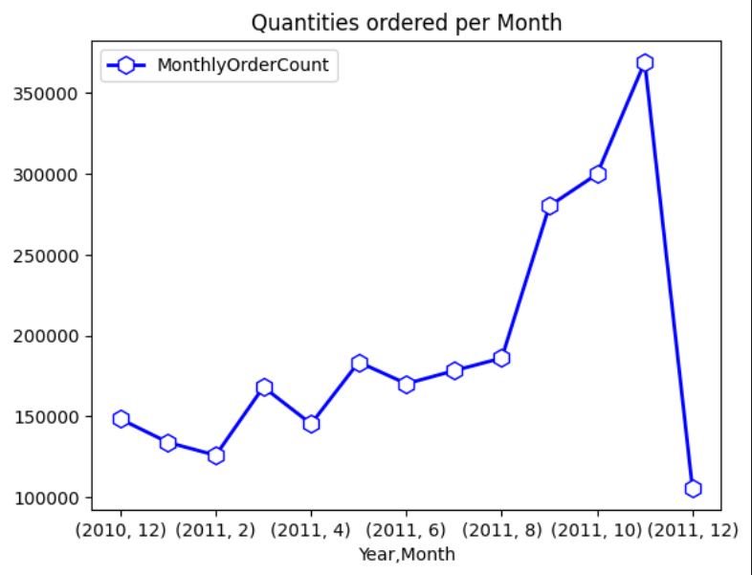
7. Monthly Revenue

Slide 34
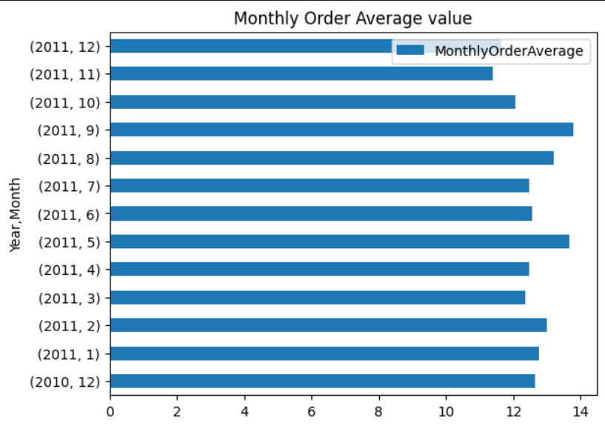
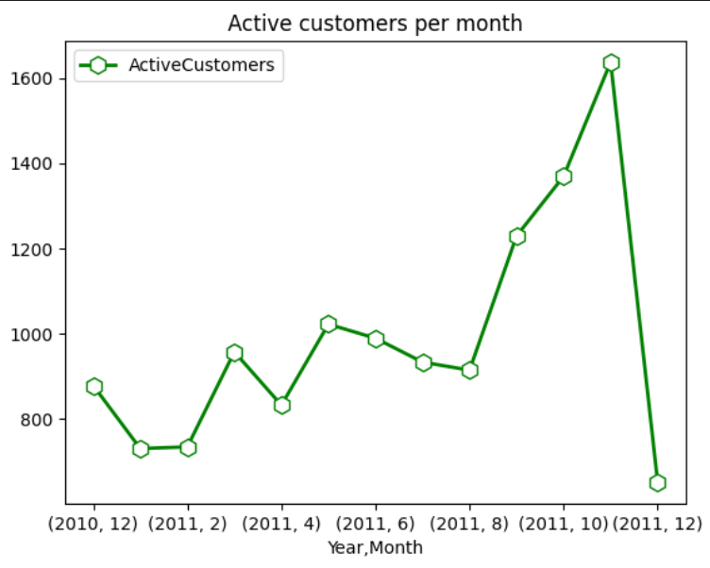

Slide 35
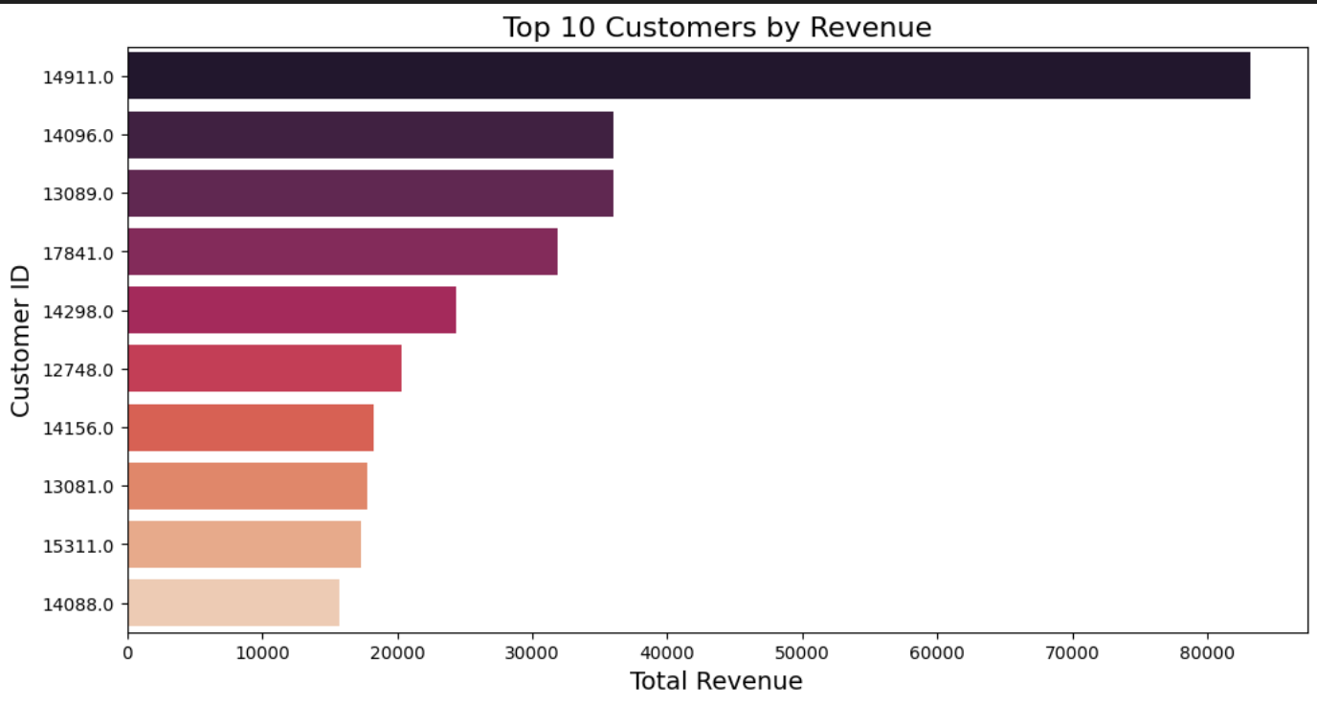

Slide 36
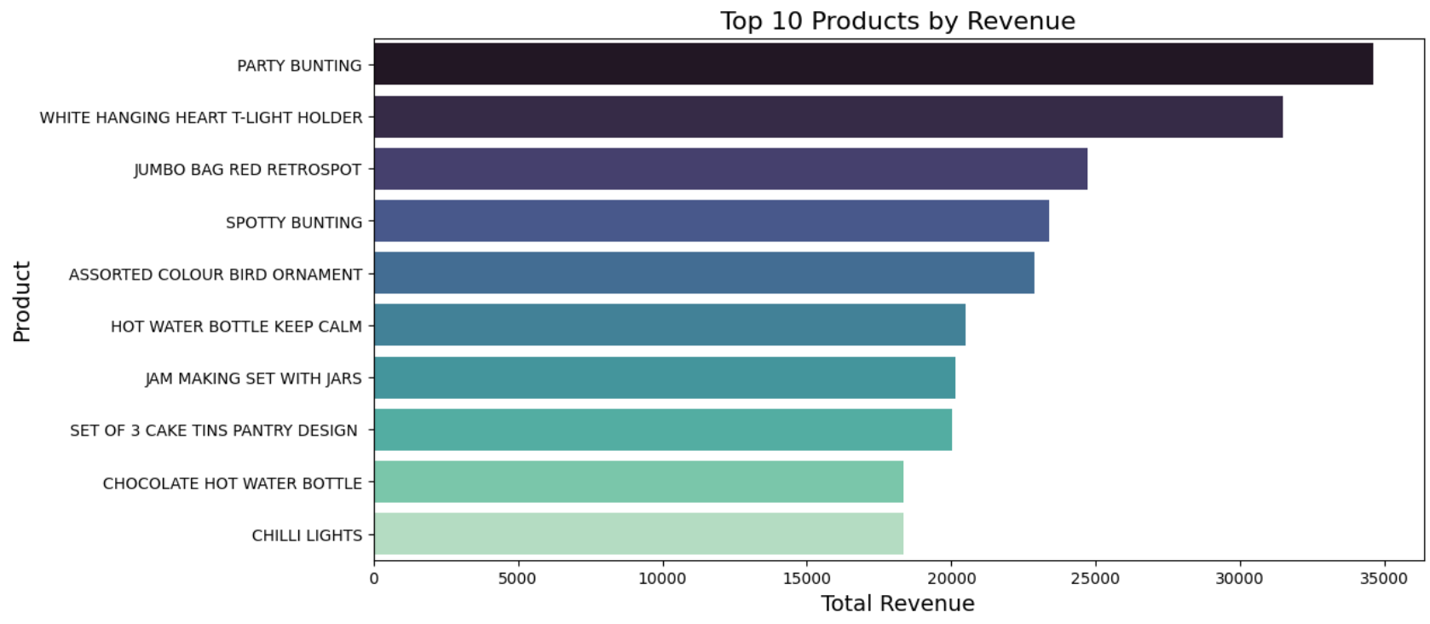

Slide 37
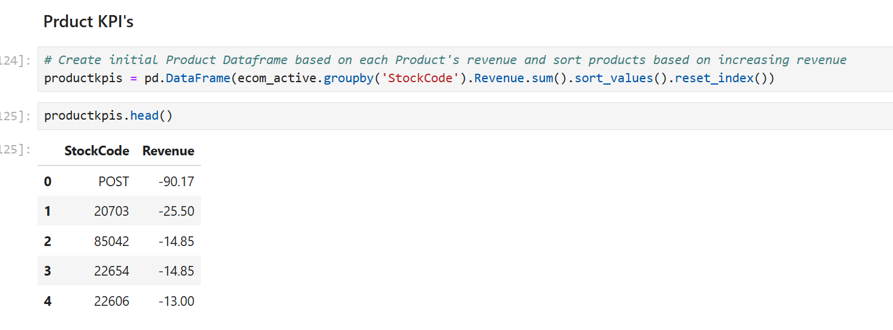

Slide 38
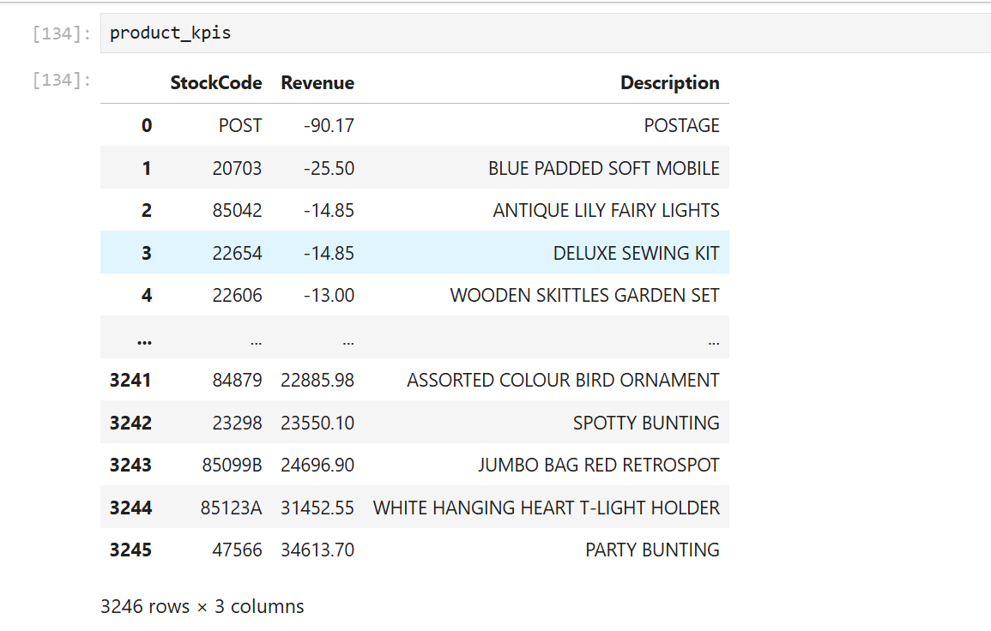

Slide 39
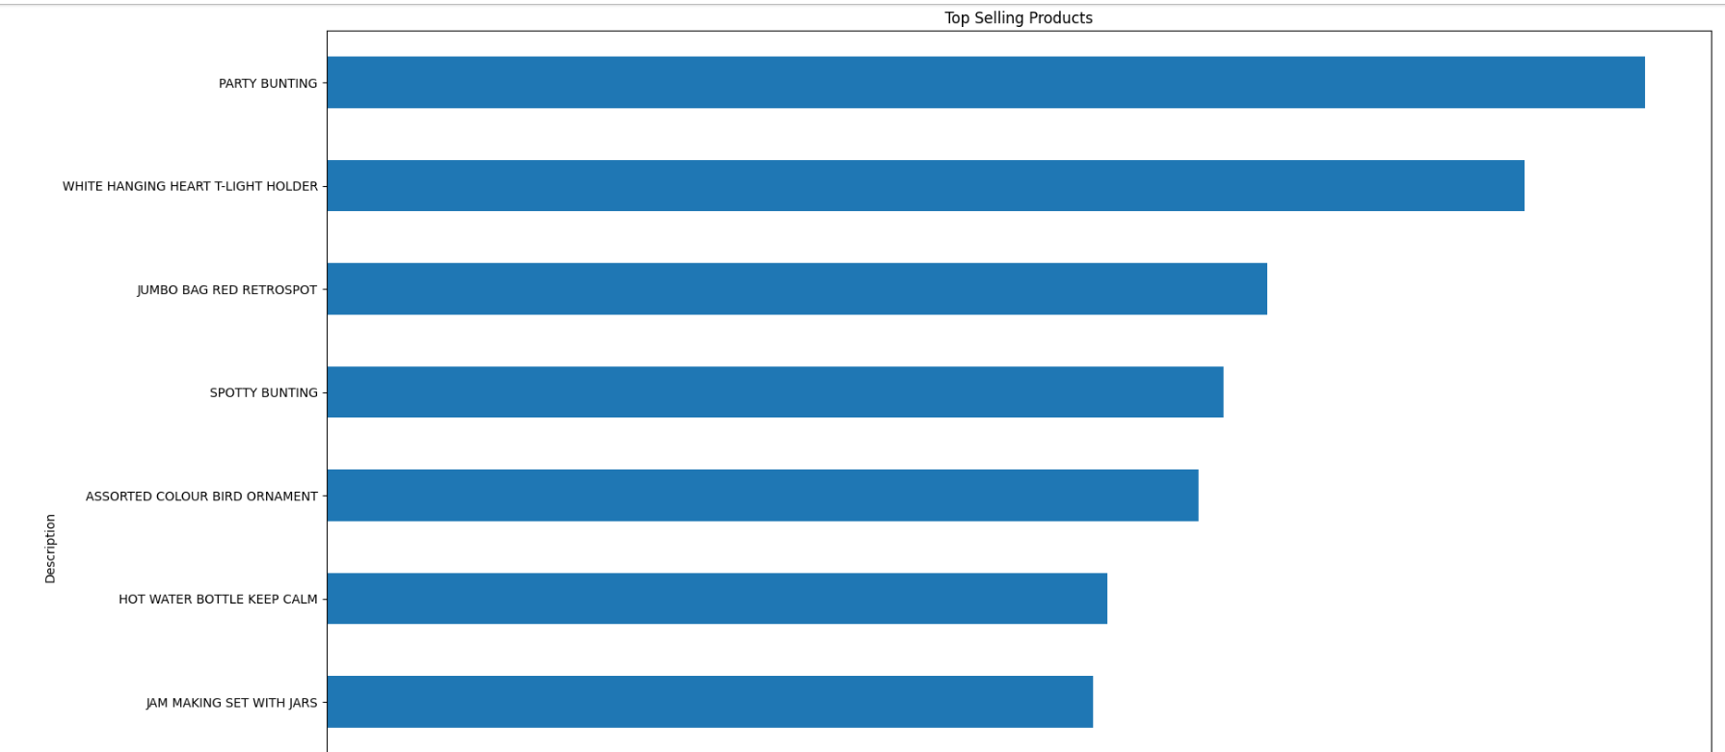

Slide 40
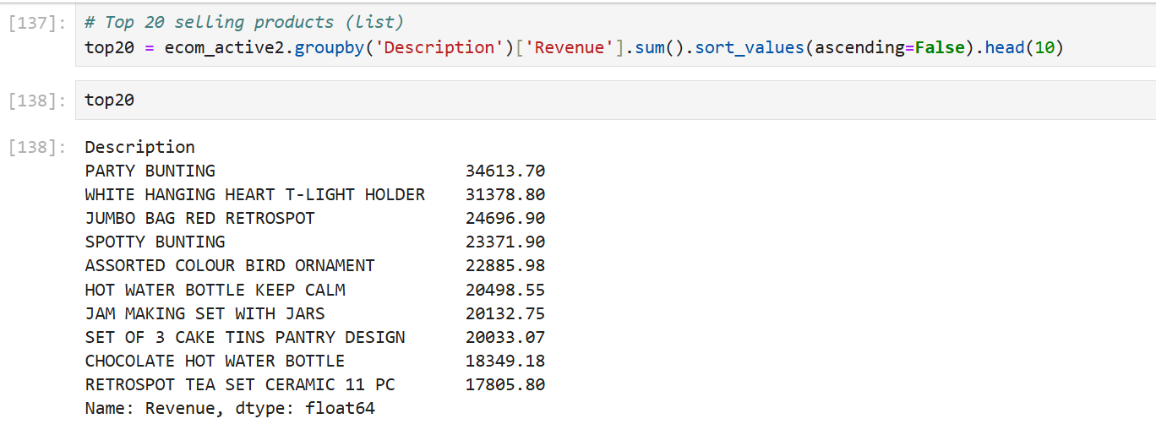

Slide 41
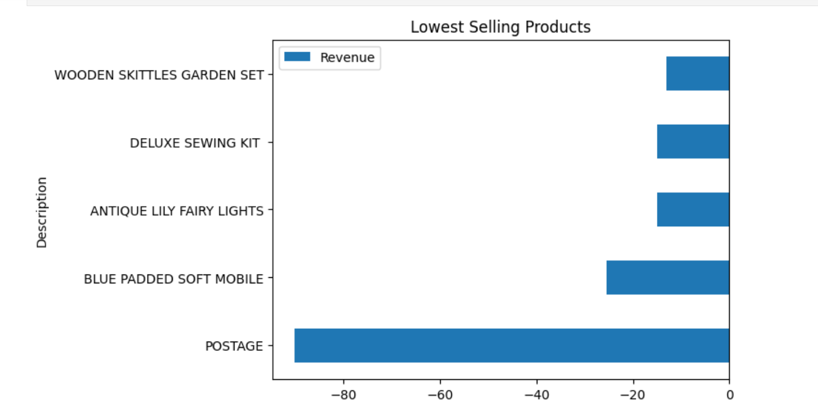

Slide 42
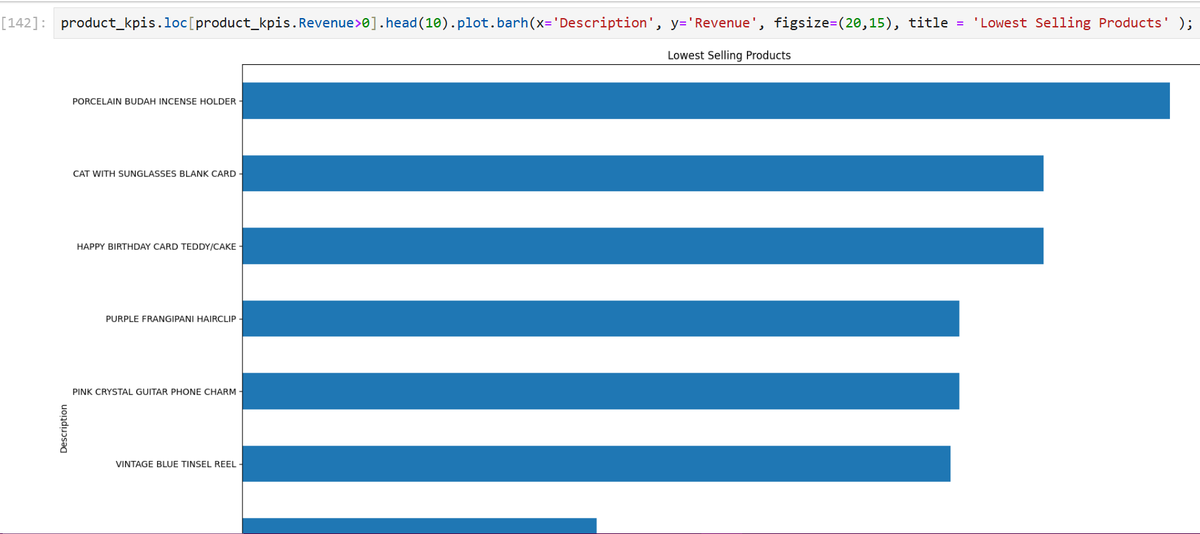

Slide 43
8. RFM Analysis
Here I was generate some new feature like : Generating Revenue and extracting of timing.
Here this is based on market and customer purchase scenario to I will make RFM analysis.
RFM stands for Recency – Frequency – Monetary value for following definitions.
Recency : Given a current or specific date in the past, Recency captures the last time that the customer made a transaction.
Frequency: Given a specific time window, Frequency captures the number of transactions the customer did during that window.
Monetary Value or Revenue : Given a specific window, Revenue captures the amount spent by the customer.

Slide 44
FUTURE SCOPE OF MY PROJECT PATH VIEW BASED ON RECENCY, FREQUENCY, MONETARY VALUE
Low Value Segment
Mid Value Segment
R | Less Active
F | No Very Frequent
M | Low Spend
R | Medium Activity
F | Frequent at Specific Time
M | Overall in the mid of the Scale
High Value Segment
R | Very Active
F | Very Frequent
M | Grate Spending Profile

Slide 45
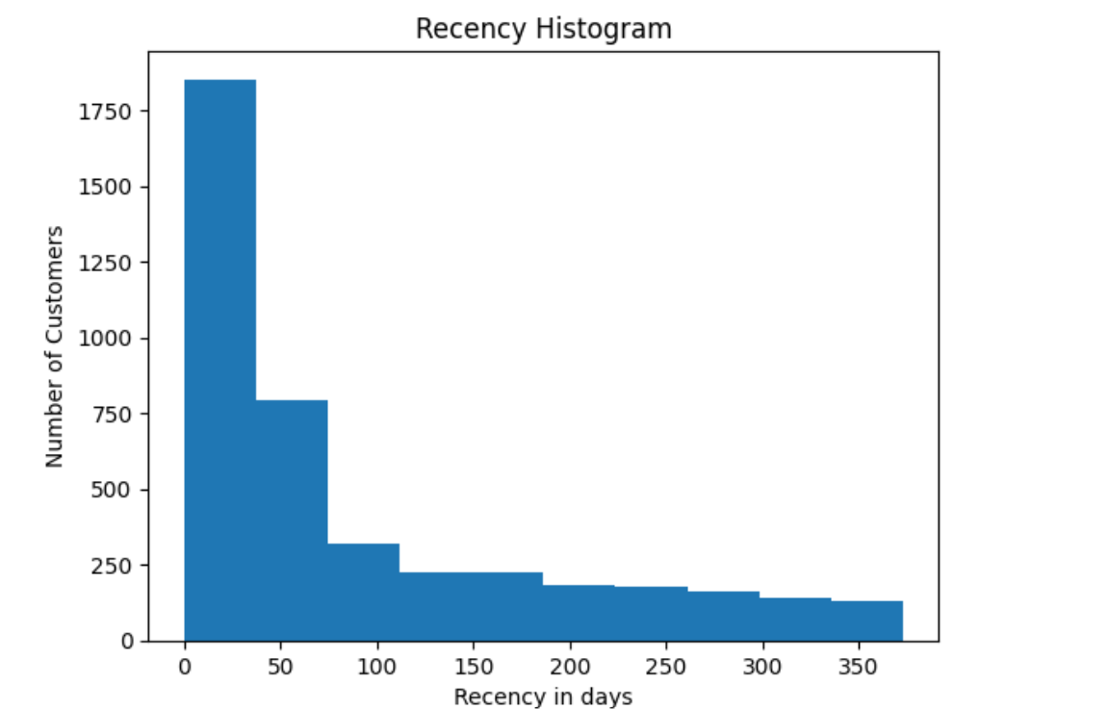

Slide 46
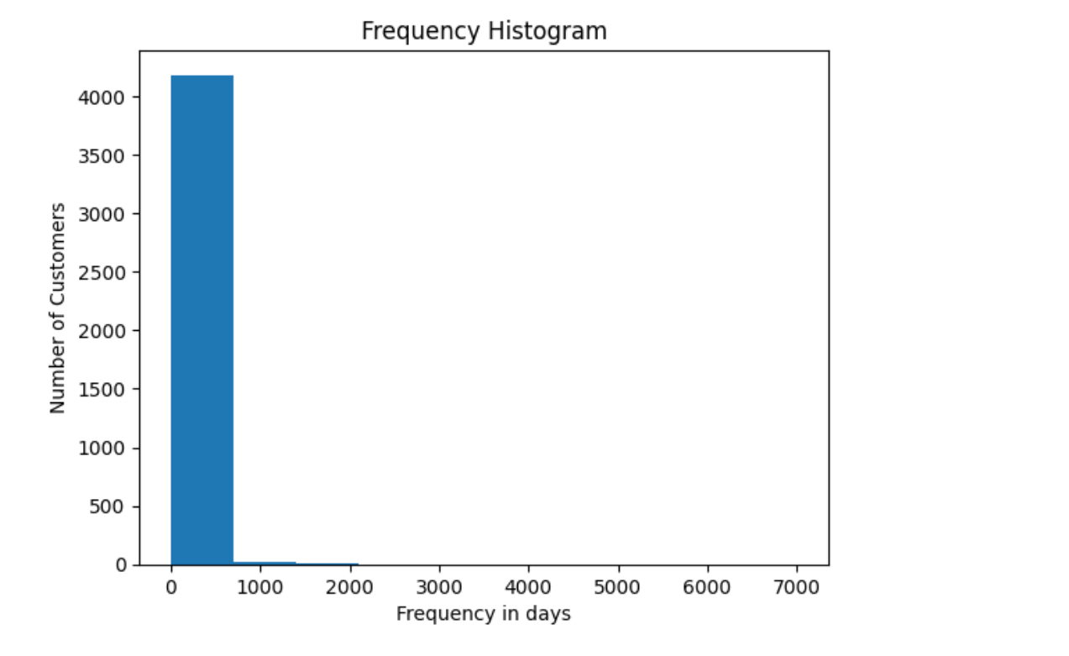

Slide 47
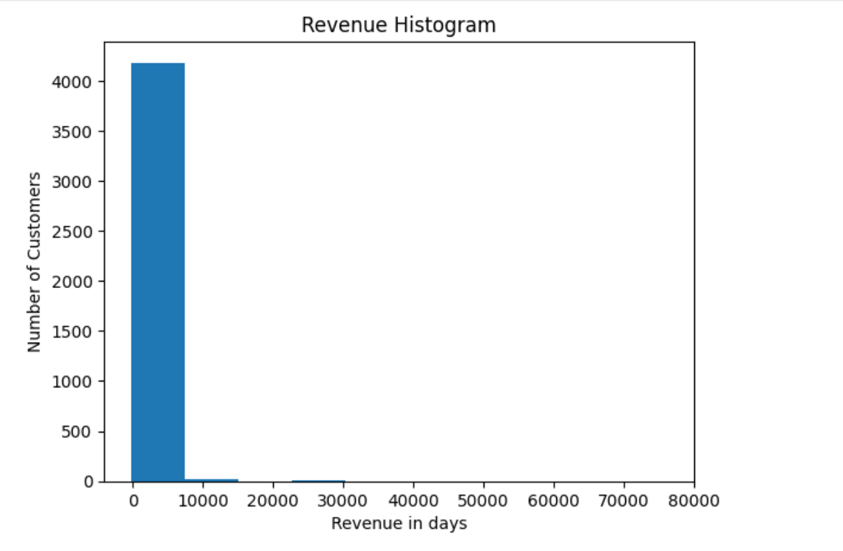

Slide 48
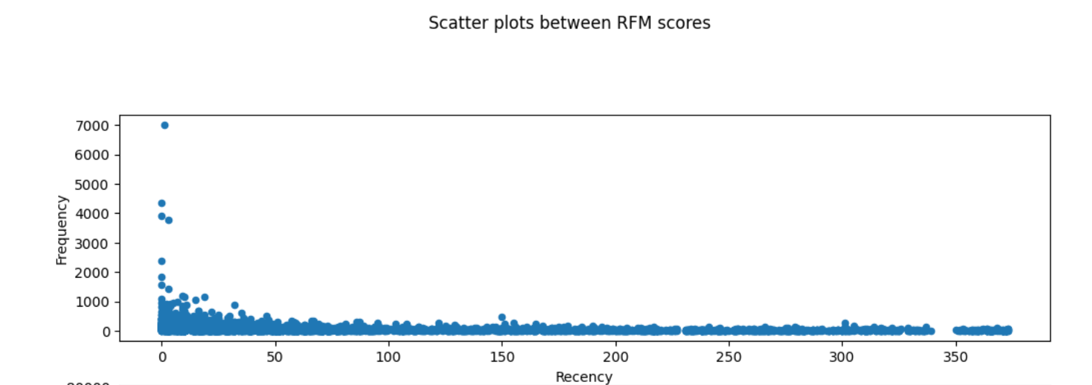

Slide 49
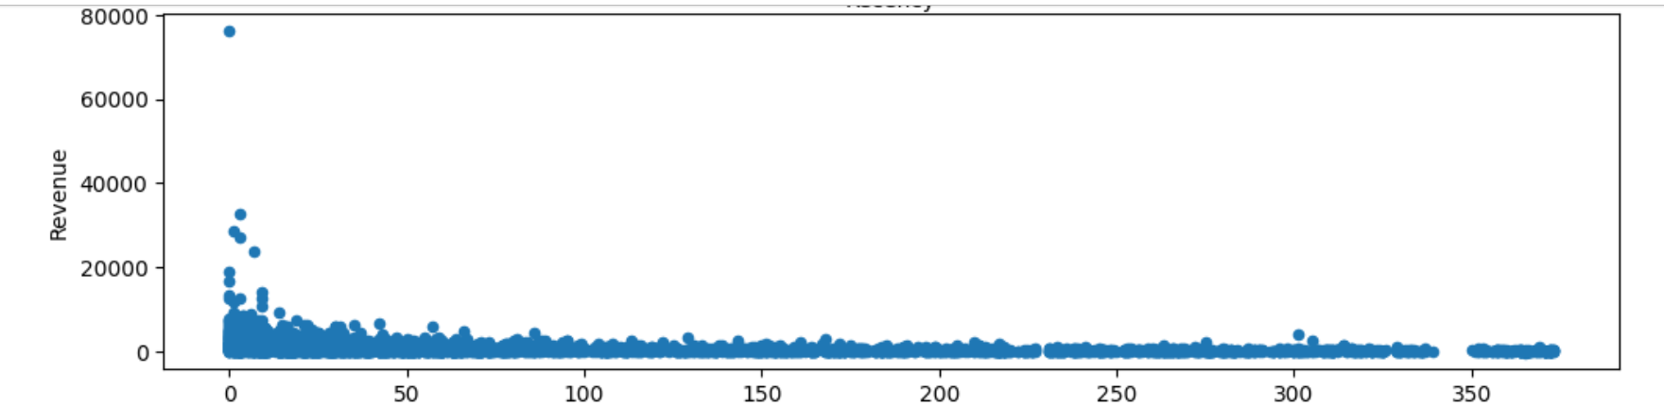

Slide 50
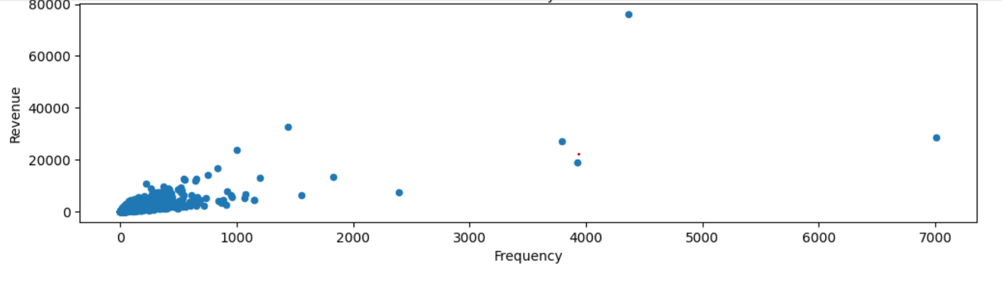

Slide 51
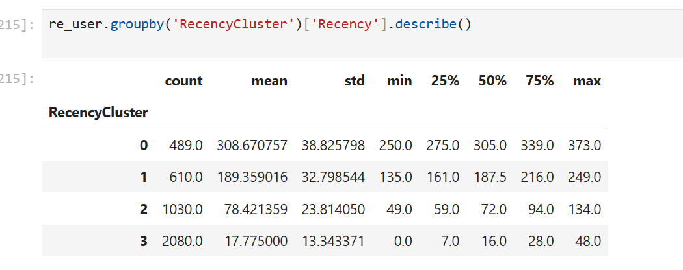
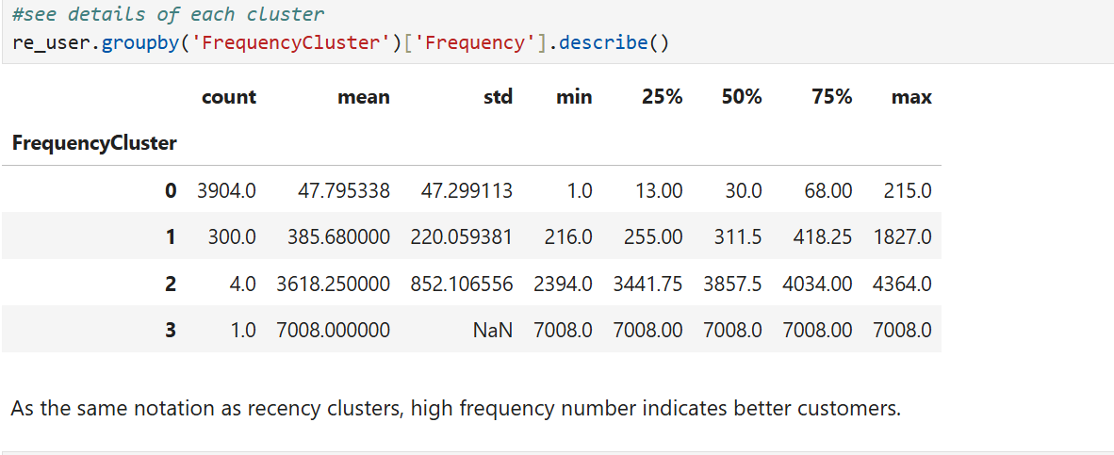
9. RFM Modeling

Slide 52
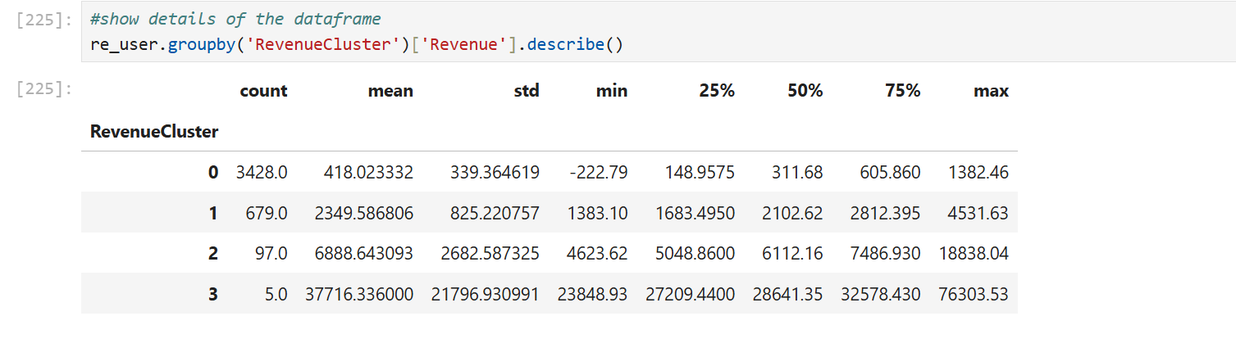
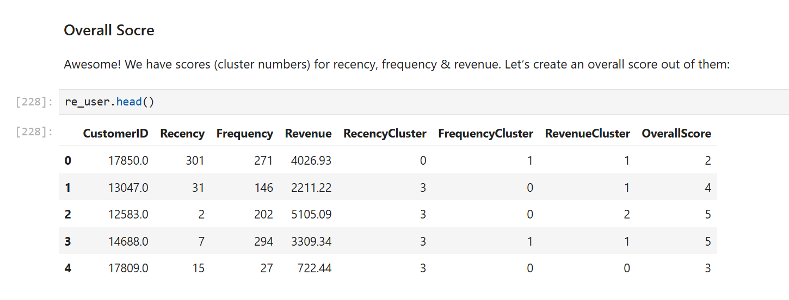

Slide 53
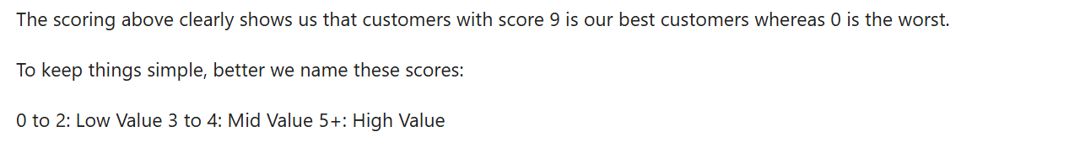

Slide 54
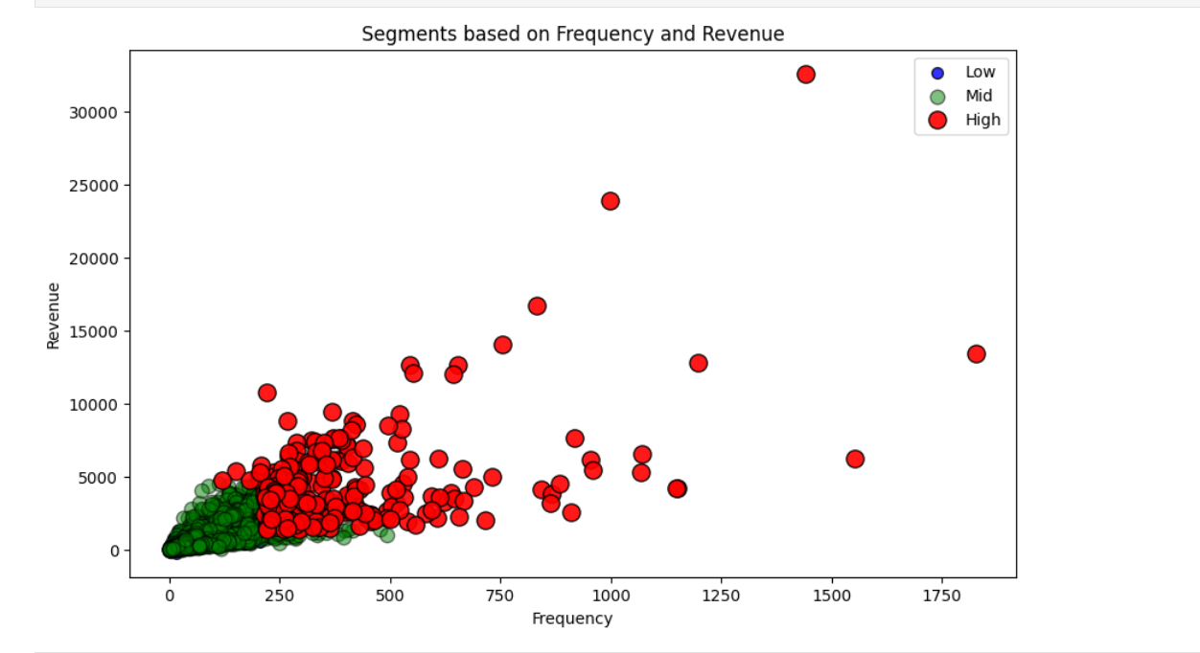

Slide 55
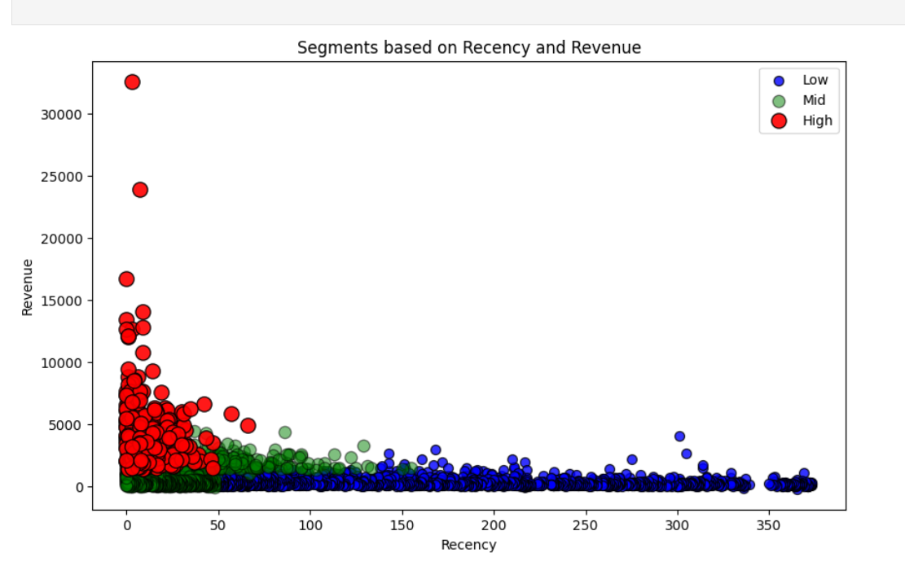

Slide 56


Slide 57

10. Customer Life Time Value Prediction

Slide 58


Slide 59



Slide 60



Slide 61


Slide 63

11. Supervised Machine Learning Modeling Accuracy

Slide 64

12. Best of ML Modeling Accuracy

Slide 65


Slide 66


Slide 67
Next Steps and Recommendations
Model Deployment
Deploy the trained models into the company's systems to enable real-time predictions and recommendations. Module using in my model : K-MODES CLUSTERING ALGORITHM, DBSCAN, HIERARCHICAL AGGOLOMETRATIVE CLUSTERING & ALSO USING SUPERVISED ML ALGORITHMS.
1
Continuous Monitoring
2
Continuously monitor the performance of the models and adjust them as needed based on changes in customer behavior or data availability.
Expansion and Refinement
3
Explore opportunities to expand the scope of the project, incorporating additional data sources and refining the models to provide even more accurate and insightful predictions.

Slide 68
Thank You!

